Slide 1
Flights Status Prediction
Flight departing from SEA

Slide 2


Introduction

Slide 3

Why we picked this topic?
Taking flights is an essential part of our daily life
Flight delays can cause significant inconvenience

Slide 4

Whether the flights departing from SEA will be on time or delayed?
Our scope is narrowed down to the flights departing from Seattle-Tacoma Int’l Airport (SEA)
Data of year 2022
Flight data: U.S. DOT’s Bureau of Transportation Statistics
Weather data: National Centers for Environmental Information (NOAA)
Models to use:
Naive Bayes Model
Logistic Regression Model
Software: Python

Slide 5
Analysis

Slide 6

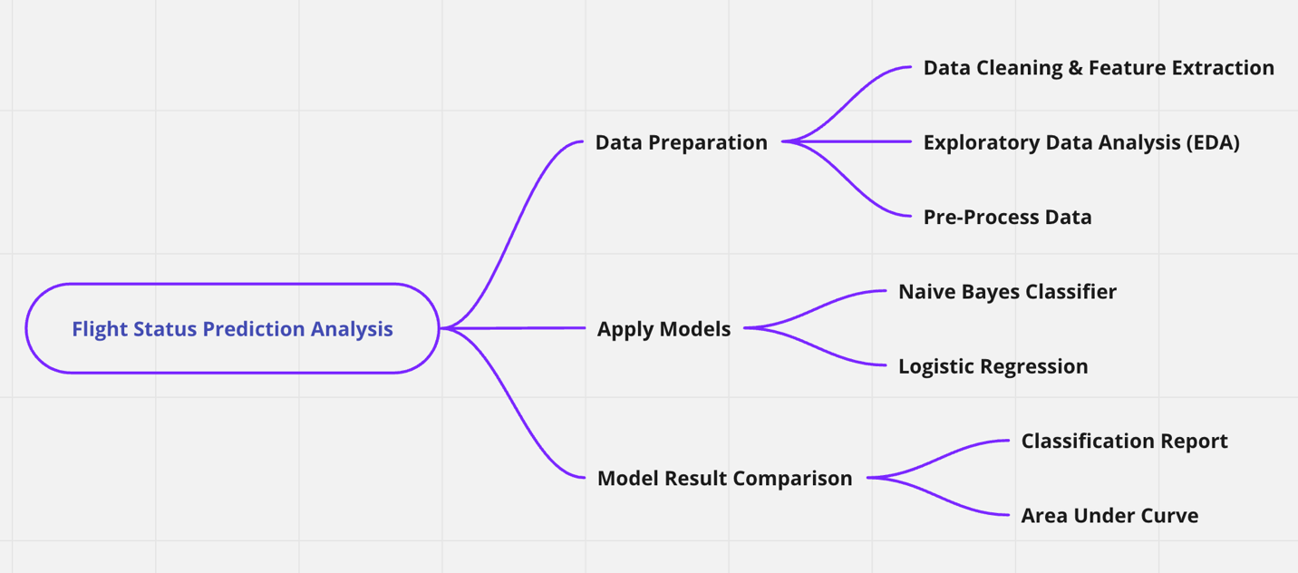

Slide 7
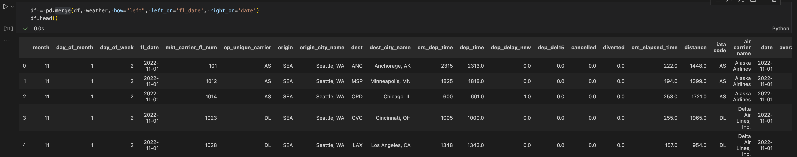
Data Preparation —— Data Cleaning and Feature Extraction
Merged two datasets (174009 rows * 31 columns)

Slide 8
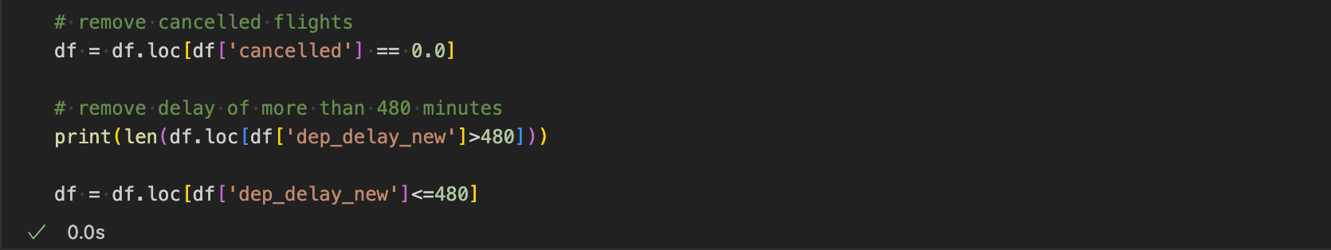
Data Preparation —— Data Cleaning and Feature Extraction
Removed cancellations (3473 records, 2% of total record) and outliers (190 records, 0.1% of total data)
Some irrelevant and redundant columns such as taxing time, actual elapsed time, and arrival time were removed as well.

Slide 9
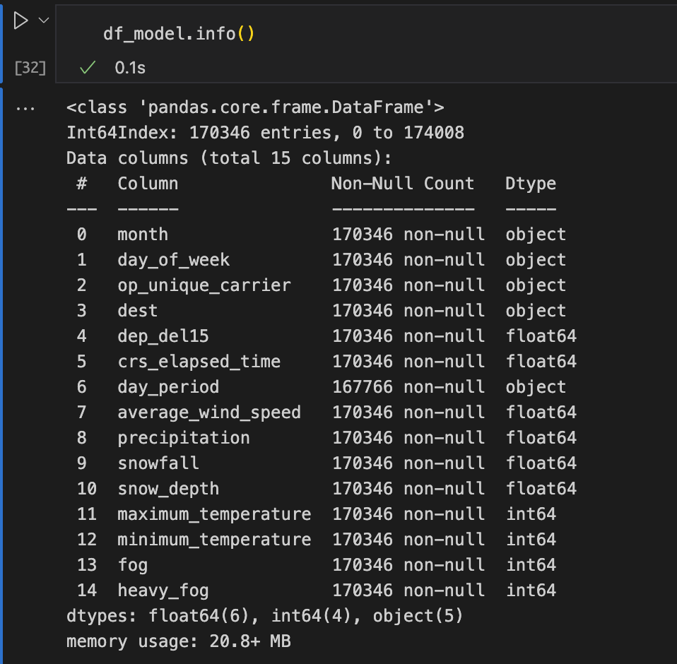
Data Preparation —— Data Cleaning and Feature Extraction
A dataset of dimensions 170346 rows × 15 columns was obtained with the following features.
Target variable: dep_del15 (Binary indicator whether a flight got delayed)
Categorical features: Airline, Destination
Numerical features: Schedule elapsed time, Max and Min temperatures, Average wind speed, Precipitation, Snowfall, Snow depth, Fog, Heavy fog
Date/Time features: Month, Day of week, Day period (morning, afternoon, evening, after midnight)

Slide 10
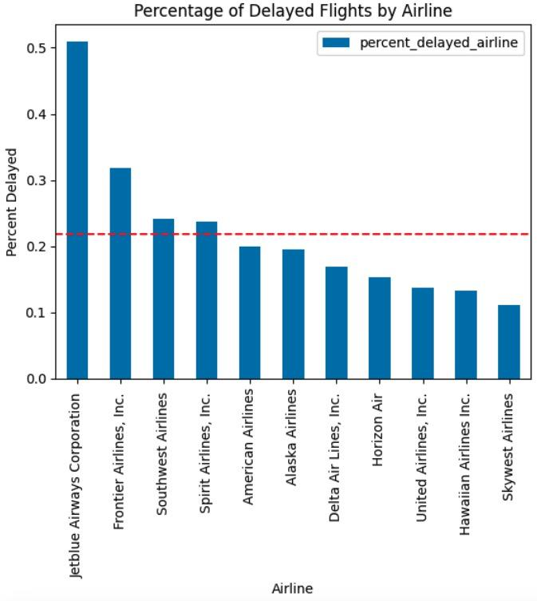
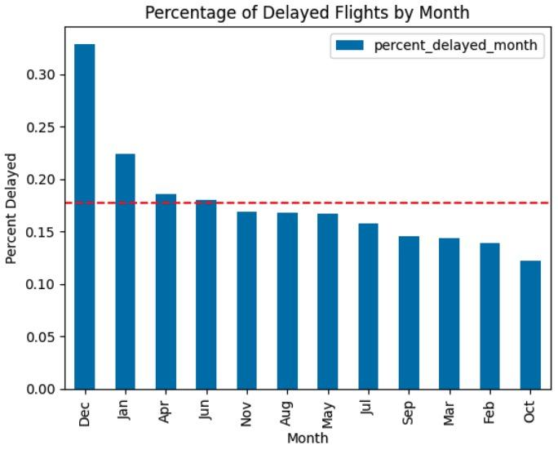
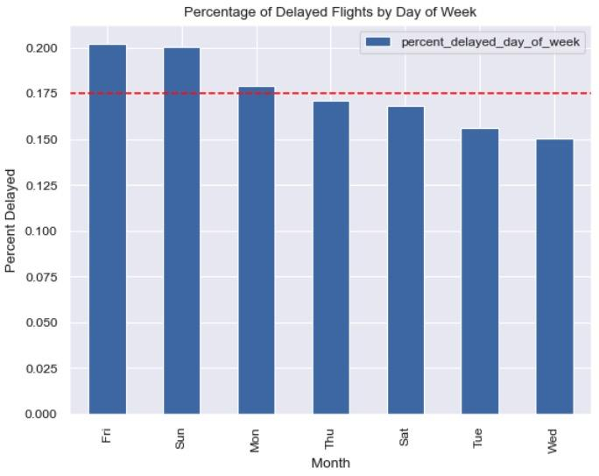
Data Preparation —— Exploratory Data Analysis (EDA)

Slide 11
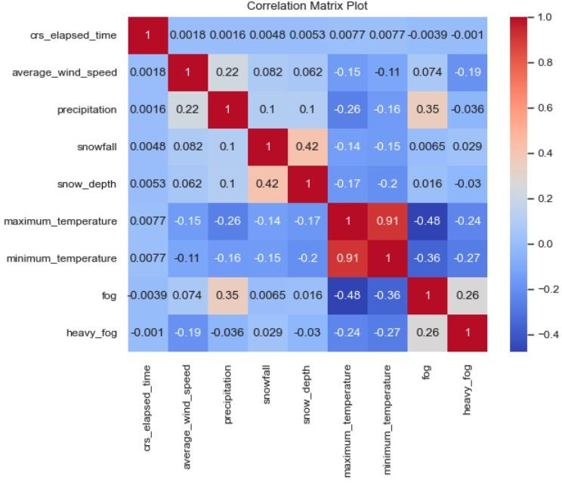
Data Preparation —— Exploratory Data Analysis (EDA)
Except for the maximum and minimum temperatures, there are no significant correlations between any of the variables.

Slide 12
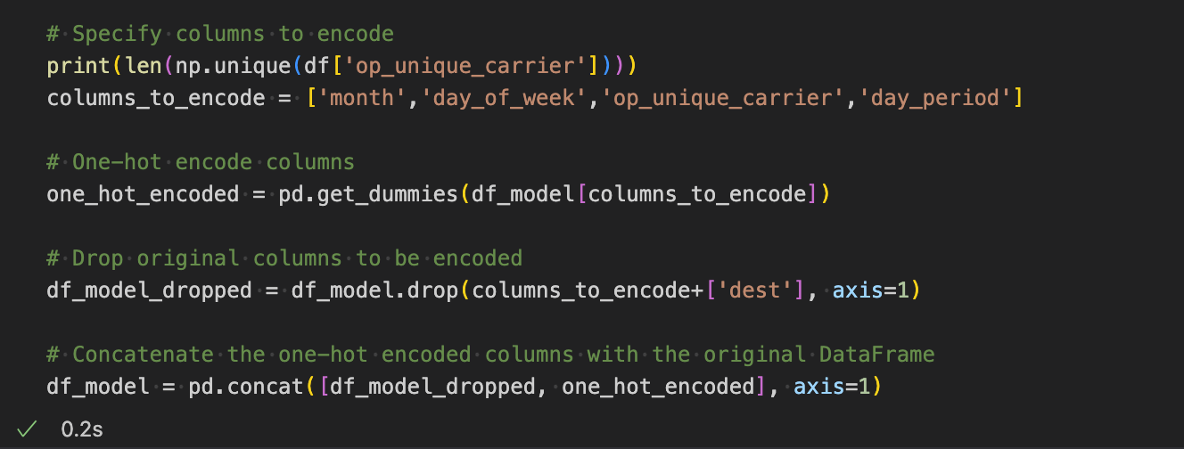
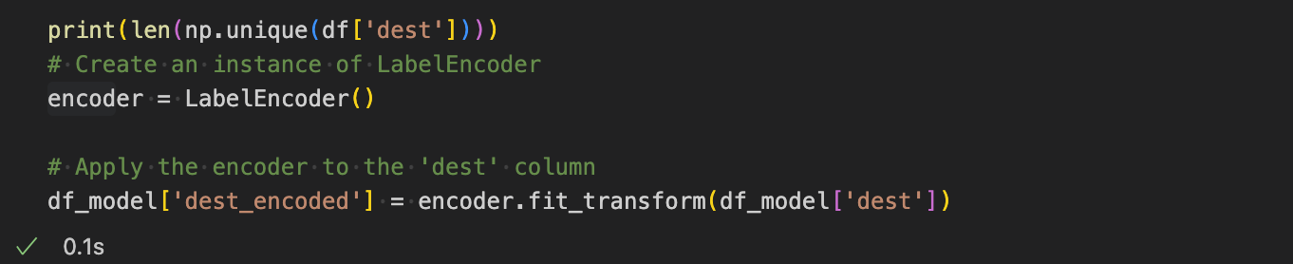
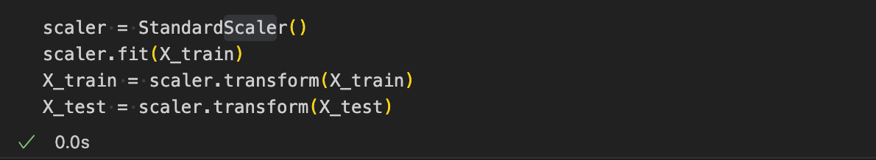
Data Preparation —— Pre-process Data
One-Hot Encoding:
Airline (11)
Month (12)
Day of week (7)
Day period (7)
Label Encoding :
Destination (94)
Standard Scaler

Slide 13
Apply Models —— Naive Bayes Classifier & Logistic Regression
Split dataset to training/test data (80:20)
Generate models on the training set
Use test data to validate the performance of models
Notes:
After pre-processing data, we applied Navie Bayes and Logistic Regression model to our dataset. First, we carried out a train-test split, allocating 80% for training and 20% for testing. Then, we utilized the Naive Bayes Classifier and Logistic Regression models from the Sklearn library in Python to train our models. We then generated relevant graphs and metrics to analyze and compare the performance of these two models.

Slide 14

Apply Models —— Naive Bayes Classifier & Logistic Regression
Naive Bayes Classifier
Based on Bayes' theorem – conditional probabilities
Let $E_{1}, E_{2}, E_{3}...E_{n}$ be a set of events associated with sample space S.
Let A be any event which occurs with $E_{1}or E_{2} or E_{3}...or E_{n}$:
$P(E_{i }| A) = \frac{P(E_{i})P(A|E_{i})}{\sum_{k = 1}^{n}{P(E_{k)}P(A|E_{k})}}$ , i = 1, 2, 3…,n
Simple yet effective algorithm that can handle large datasets with many features.
Logistic Regression
Widely used machine learning algorithm in binary classification problems
Can handle large datasets
Notes:
Naive Bayes is a machine learning algorithm, and it is based on Bayes' theorem, which is a foundational principle in probability theory that we learned in this class. This theorem calculates the likelihood of an event by taking into account of previous knowledge of information, which gives us conditional probabilities. It is a simple but effective algorithm for large datasets with many classes or features.
We also picked Logistic Regression algorithm for this project as it’s widely used for binary classification problems and can handle large datasets as well.

Slide 15
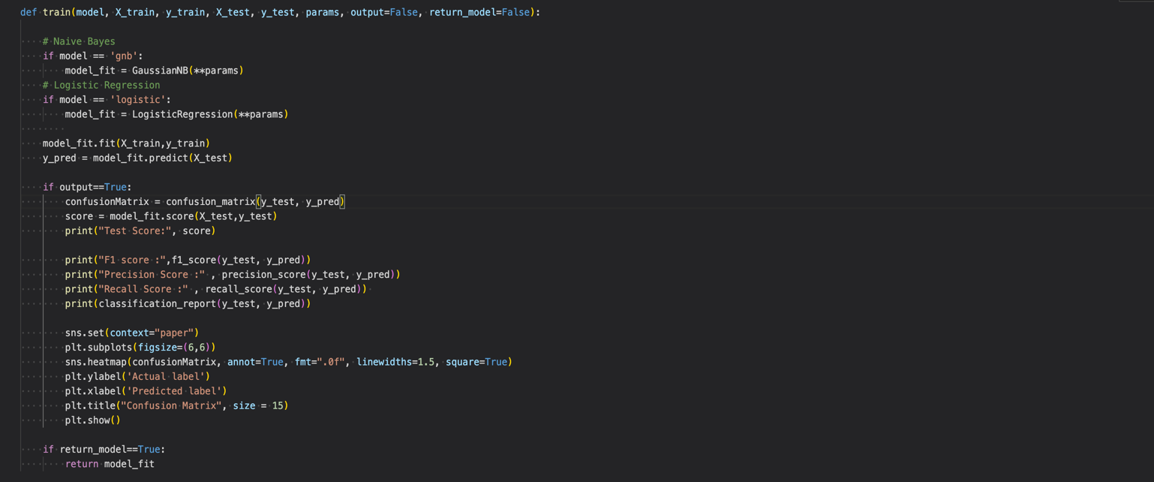
Notes:
These codes show how we applied training and test datasets to these two models and generated model results. The details can be obtained from our final report so we won’t elaborate it at this moment.

Slide 16

Model Results Comparison —— Test Score (Accuracy)
 | Naive Bayes Classifier | Logistic Regression
Test Score | 0.793 | 0.825
Logistic Regression model has a higher accuracy than Naive Bayes Model
Notes:
To compare the results of two models, we first looked at the test score or accuracy, which is a measure of how well a model is able to correctly predict the outcomes of a test dataset. In our case, the Logistic Regression model correctly predicted 82.5% of the flight departure status in the test dataset, and this is higher than the accuracy of the Naïve Bayes model.
It is calculated by dividing the number of correct predictions made by the model, by the total number of predictions made on the test dataset.

Slide 17
Model Results Comparison —— classification Report
 | Predicted label 0 (On-time) |  | Predicted label 1 (Delay)
Test (n=34070) | Naive Bayes | Logistic Regression | Naive Bayes | Logistic Regression
Actual 0 (=28087) | 25751 | 27885 | 2336 | 202 (False Positives)
Actual 1 (=5983) | 4710 | 5750 (False Negatives) | 1273 | 233 (True Positives)
Precision | 0.85 | 0.83 | 0.35 | 0.54
Recall | 0.92 | 0.99 | 0.21 | 0.04
f1-score | 0.88 | 0.90 | 0.27 | 0.07
Precision = True Positives / (True Positives + False Positives)
Recall = True Positives / (True Positives + False Negatives)
F1 score = 2 * (precision * recall) / (precision + recall)
Correctly predicting delayed flights need to be improved.
Notes:
The classification report presents a breakdown of the predicted labels (0 or 1) produced by each model and compares them with the true labels (0 or 1). Again, 0 here stands for on time and 1 stands for Delay. For example, the Naive Bayes model correctly predicted that 25,751 instances were on time (labeled as 0), but it incorrectly classified 4,710 instances as on time (labeled as 0) even though they were actually delayed flights. The classification report also summarizes the key performance metrics: Precision, Recall, and F1-score.
The calculation of each score is given here.
From the classification report, we can tell that the performance of each model in correctly predicting delayed flights needs to be improved.
When the logistic Regression model is predicting delayed flights:
The precision score of 0.54 indicates out of all the flights that the model predicted would get delayed, 54% did delay. precision quantifies how often the model correctly predicts the positive class out of all the times it predicted the positive class. Higher precision scores indicate that the model is making fewer false positive predictions and is more accurate in identifying positive instances.
The recall score of 0.04 measures the proportion of actual delays that were correctly predicted as delayed by the model. In other words, out of all the flights that actually did delay, only 4% were correctly predicted by the model. A high recall score means that the model is minimizing false negative predictions and is able to identify a larger percentage of the positive instances in the dataset.
The F1 score of 0.07 is a metric that combines precision and recall scores into a single score, providing a balance between the two.

Slide 18
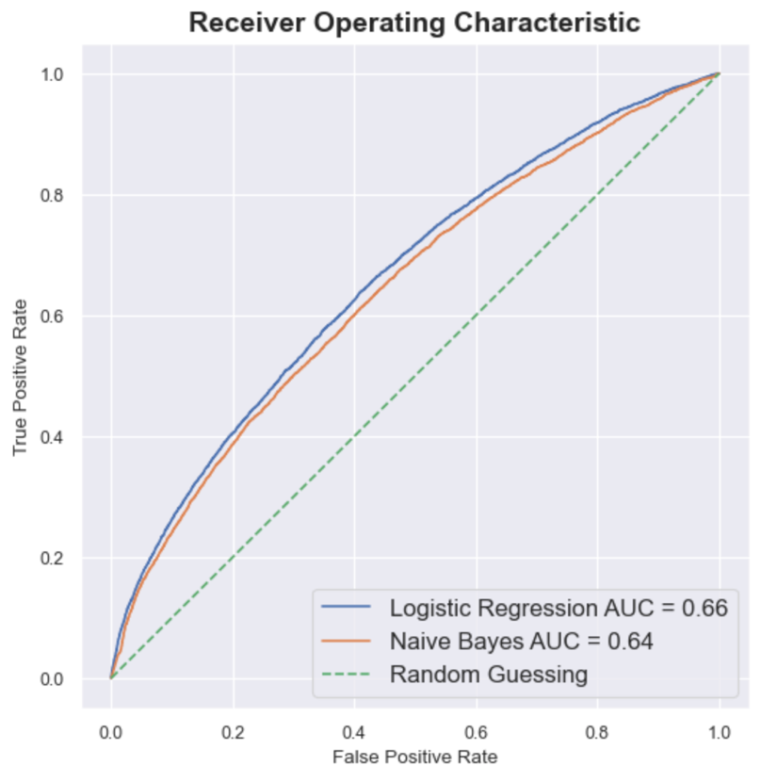
Model Results Comparison —— Area Under Curve (AUC)
The performance of the Logistic Regression model is superior, based on AUC.
Notes:
Next, we used AUC to compare the performance of two models.
AUC (Area Under the Curve) plots the true positive rate against the false positive rate at various thresholds. The value of AUC ranges from 0 to 1, with a higher value indicating better performance.
On the graph, the larger area under the curve, the better the model is. Here, the performance of the logistic regression model is superior to the naïve bayes model.
TPR = TP / (TP + FN): sensitivity TPR measures the fraction of actual positive cases that the model correctly identifies as positive, out of all the positive cases in the data.
FPR = FP / (FP + TN): 1-sensitivity FPR measures the fraction of actual negative cases that the model incorrectly identifies as positive, out of all the negative cases in the data.

Slide 19
Conclusion
Notes:
This is our last part, conclusion.

Slide 20
Conclusion —— Question Answered
There isn't a significant difference in the outcomes between the Logistic Regression Model and Naive Bayes Model.
Logistic Regression Model is overall better than the Naive Bayes Model, with an accuracy of 82.5%.
Using our model, passengers can make informed decisions, regarding their travel plans based on the predicted departure status of their flights.
Notes:
From analysis above, we found that there is no big difference in the outcomes between the Logistic Regression Model and the Naive Bayes Model. However, the Logistic Regression Model demonstrates a slightly better performance, with an overall accuracy of 82.5%, though its recall and F1 scores are not very good. By utilizing our predictive model, passengers can make informed decisions regarding their travel plans.

Slide 21
Conclusion —— weakness & limitations
Not accurate enough - limitation of the models
Performance in correctly predicting delayed flights need to be improved – data source bias
Other factors that are not considered
Notes:
Our model has several weakness and limitations.
Though our model has some predictive power, it may not be as accurate as desired. This is caused by the limitation of the models we chose. To get a better overall result, we might use more advanced machine learning techniques such as decision tree and random forest to predict flight status.
In addition, the model shows a higher tendency to predict on-time flight status, potentially compromising its accuracy. This could be a result of that our models seem to be influenced by the imbalanced data, as 80.7% of flights are on-time. To avoid this bias, we can create synthetic samples for delayed flights by using SMOTE function.
Last but not the least, there may be other factors such as airline preparedness, airport conditions, and passenger-related issues that have not been considered in our model, potentially impacting the overall prediction quality.
Despite these limitations, our model still offers valuable insights for passengers about the flight status.

Slide 22
Conclusion —— What we learned
Utilized Naive Bayes algorithm in real-life scenarios
Broadened understanding of machine learning models
Utilized Python libraries for data manipulation and transformation, model building and visualization
Developed analytical abilities to scrutinize data
Implemented and evaluated different algorithms and models
Ignited passion for delving further into the realm of data science
Notes:
Through the project we were able to apply the Naive Bayes algorithm in real-life scenarios, we have gained a broader understanding of machine learning models. By leveraging Python libraries for data manipulation, transformation, model building, and visualization, we have sharpened our analytical abilities to scrutinize data. Furthermore, the implementation and evaluation of different algorithms and models have ignited our passion for delving deeper into the realm of data science.

Slide 23
Q&A
Notes:
That’s the end of our presentation. Thanks for your time and feel free to ask questions if any.

